Slide 1
CA2
Mobile Development

Slide 2
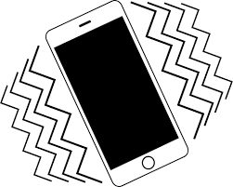
Vibrate Feature
For the likes of the image carousel animation, we could implement a feature that makes the phone vibrate when the image lands

Slide 3

Upload Sketches Directly into App
We could also implement a feature that allows Creators to take images of their creations within the application and upload them instantly

Slide 4
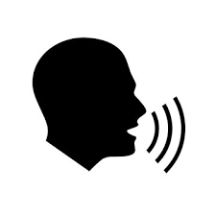
Voiceover
Ability to record a voiceover within app that could be used to talk a user through the likes of a creators Storyboard.

Slide 5

Follow Feature (Notifications)
Ability for anyone viewing the application to follow the content creator and receive notifications when they change the content in their pages, whether that be text or images.

